Slide 1

Computer System Architecture
Course Code IT2101
Subject Guide: Dr. Aprna Tripathi

Slide 2
Course Objectives:
The core objective of this course is to describe the general organization and architecture of a computer system.
It covers in detail the description and design of basic computer, functional units, machine instructions, control unit and memory hierarchy design.
It provides a detailed coverage of logic circuits to perform various arithmetic operations and use of pipelining to achieve parallelism to achieve at different levels using hardware and software techniques to yield high-performance processors.

Slide 3
Course Outcomes:
A student who successfully fulfills the course requirements will be able to:
[2101.1]. Understand the concepts of different combinational and sequential circuits.
[2101.2]. Explain various microoperations and different components of computer organization.
[2101.3]. Describe the operations of control unit and design of various arithmetic circuits.
[2101.4]. Analysis the concepts of I/O organization and memory organization.
[2101.5]. Illustrate the working of pipelining, its interconnection structure and architecture of different processors.

Slide 4
Student Outcomes (SO):
An ability to apply the knowledge of mathematics, science and computing appropriate to the discipline
An ability to analyze a problem, identify and define the computing requirements appropriate to its solution.
An ability to design, implement and evaluate a system / computer‐based system, process, component or program to meet desired needs

Slide 5
Assessment Pattern:
At least four assignment
Three quizzes out of which best two will be considered
Quiz can be conducted before announcement
In final assessment
Assignment- 10
Quiz – 10

Slide 6
Syllabus
Basics of Digital Electronics: Codes, Logic Gates, Flip-Flops, Registers, Counters, Multiplexer, De-multiplexer, Encoder, Decoder;
RTL and Micro Operations: Register Transfer, Bus and Memory Transfer, Logic Micro Operations, Shift Micro Operations;
Basic Computer Organization: Complete Computer Description & Design of Basic Computer, Instruction Codes, Computer Instructions, Timing & Control, Instruction Cycles, Memory Reference Instructions, Input/output & Interrupts;
Control Unit: Hardwired vs. Micro Programmed Control Unit, Central Processing Unit, General Register Organization, Stack Organization, Instruction Format, Data Transfer & Manipulation, Program Control, RISC, CISC;
Computer Arithmetic: Addition & Subtraction, Multiplication Algorithms, Division Algorithms;
Input-Output Organization: Peripheral devices, I/O interface, Data Transfer Schemes, Program Control, Interrupt, DMA Transfer, I/O Processor;
Memory Unit: Memory Hierarchy, Processor vs. Memory Speed, High-speed Memory, Cache Memory, Associative Memory, Interleave, Virtual Memory, Memory Management;
Introduction to Parallel Processing: Pipelining, Characteristics of Multiprocessors, Interconnection Structures, Inter-processor Arbitration, Inter-processor Communication & Synchronization;
Case Studies: Case Studies of some Contemporary Advanced Architecture for Processors of Families like Intel, AMD, IBM.

Slide 7
Text Books:
The main textbook is:
T1. M. Morris Mano, “Computer System Architecture”, Pearson, 3rd Edition Revised, 2017.

Slide 8
Reference Books:
R1. W. Stallings, “Computer Organization and Architecture –Designing for Performance”, PHI, 2009.
R2. S. Salivahanan & S. Arivazhagan, Digital Circuits and Design, Oxford University Press; Fifth edition, 2018.
R3. David A. Patterson, John L. Hennessy, “Computer Organization and Design: The Hardware/Software Interface”, Morgan Kauffmann, 4th Edition, 2010.
R4. John P. Hayes, “Computer Architecture and Organization”, TMH, 3rd Edition, 1999

Slide 9
Input output organization

Slide 10
Peripheral devices
The input-output subsystem of a computer, referred to as I/O.
Provides an efficient mode of communication between the central system and the outside environment.
Devices that are under the direct control of the computer are said to be connected on-line.
Input or output device attached to the computer are also called peripherals.
Input
Output
Input-output
Peripherals are electromechanical and electromagnetic device.
Video monitor, printer, magnetic tape, magnetic disk

Slide 11
Input output interface
Input-output interface provides a method for transferring information between internal storage and external I/O devices.
1. Peripherals are electrotechnical and electromagnetic devices and CPU and memory are electronic devices. Therefore, a conversion of signal values may be needed.
2. The data transfer rate of peripherals is usually slower than the transfer rate of CPU and consequently, a synchronization mechanism may be needed.
3. Data codes and formats in the peripherals differ from the word format in the CPU and memory.
4. The operating modes of peripherals are different from each other and must be controlled so as not to disturb the operation of other peripherals connected to the CPU.

Slide 12
To Resolve these differences, computer systems include special hardware components between the CPU and Peripherals to supervises and synchronizes all input and out transfers. These components are called interface units.
These are providing interface between processor bus and peripheral device.

Slide 13
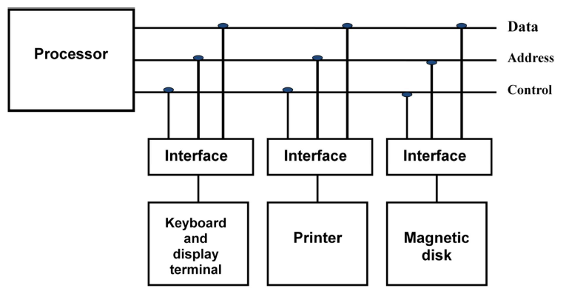
I/O bus and interface modules

Slide 14
The I/O Bus consists of data lines, address lines and control lines.
The I/O bus from the processor is attached to all peripherals interface.
Interface decodes the address and control received from the I/O.
To communicate with a particular device, the processor places a device address on address
lines.
Each interface attached to the I/O bus contains an address decoder that monitor the address line.
When the interface detects its own address, it activates the path between the bus lines and the device that it controls.
All peripherals whose address does not correspond to the address in the bus are disabled by their interface.

Slide 15
At the same time that the address is made available in the address lines, the processor provides a function code in the control lines. The interface selected responds to the function conde and proceeds to execute it. This function code referred as an I/O command.
There are four types of commands :
Control command
Status command
Data output command
Data Input command

Slide 16
Control command- A control command is issued to activate the peripheral and to inform it what to do.
Status command- A status command is used to test various status conditions in the interface and the peripheral.
Data Output command- A data output command causes the interface to respond by transferring data from the bus into one of its registers.
Data Input command- The data input command is the opposite of the data output. In this case the interface received an item of data from the peripheral and place it in its buffer register

Slide 17
Memory bus contains Data, address, and read/write control lines.
There are 3 ways that computer buses can be used to communicate with memory and I/O:
i. Use two Separate buses , one for memory and other for I/O.
ii. Use one common bus for both memory and I/O but separate control lines for each.
iii. Use one common bus for memory and I/O with common control lines.

Slide 18
Asynchronous Data Transfer
Internal timing of CPU and I/O device is independent from the other in that each uses its own clock for internal register.
This Scheme is used when speed of I/O devices do not match with microprocessor, and timing characteristics of I/O devices is not predictable. In this method, process initiates the device and check its status. As a result, CPU has to wait till I/O device is ready to transfer data. When device is ready CPU issues instruction for I/O transfer. In this method two types of techniques are used based on signals before data transfer.
Two independent unit require control signals be transmitted between the communication unit to indicating the time at which data is being transmitted.
Strobe plus supplied by one of the unit to indicate to the other unit when transfer has to occure
Handshaking : each data item being transferred with a control signal that indicate the presence of data in the bus

Slide 19
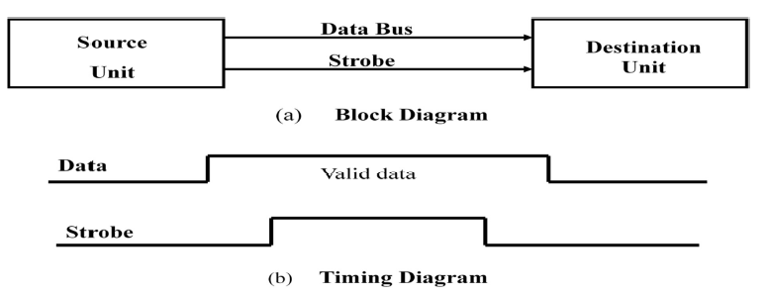
Strobe control
Activated by either source or destination.
Strobe is a single line that informs the destination unit when a valid data word is available in the bus

Slide 20
Source unit first places the data on the data bus. After the brief delay to ensure that the data settle to a steady value, the source activated the strobe pulse. The information on the data bus and the strobe signal remain in the active state for a sufficient time period to allow the destination unit to receive unit.

Slide 21
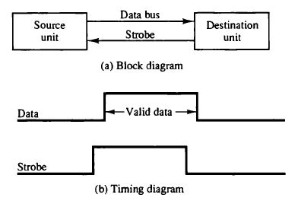
Destination activates the strobe pulse, informing the source to provide the data.
Source unit responds by placing the requested binary information on the data bus.

Slide 22
Disadvantage of Strobe Signal
The disadvantage of the strobe method is that, the source unit initiates the transfer has no way of knowing whether the destination unit has actually received the data item that was places in the bus.
Similarly, a destination unit that initiates the transfer has no way of knowing whether the source unit has actually placed the data on bus. The Handshaking method solves this problem.

Slide 23
handshaking
introducing a second control signal that provides a reply to the unit that initiates the transfer.
One control line is in the same direction as the data flows in the bus from the source to destination. It is used by source unit to inform the destination unit whether there a valid data in the bus. The other control line is in the other direction from the destination to the source. It is used by the destination unit to inform the source whether it can accept the data. The sequence of control during the transfer depends on the unit that initiates the transfer.

Slide 24
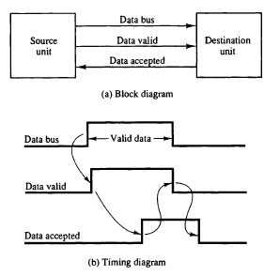
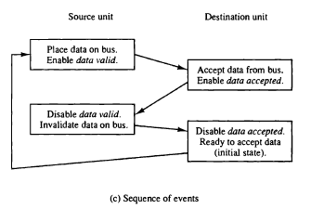
Source initiated

Slide 25
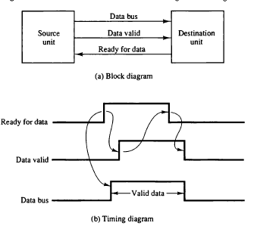
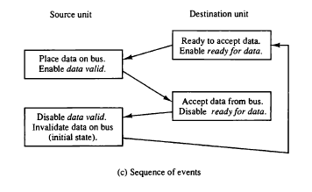
Destination initiated

Slide 26
Advantage of the Handshaking method
The Handshaking scheme provides degree of flexibility and reliability because the successful completion of data transfer relies on active participation by both units.
If any of one unit is faulty, the data transfer will not be completed. Such an error can be detected by means of a Timeout mechanism which provides an alarm if the data is not completed within time.

Slide 27
Asynchronous Serial Transmission
The transfer of data between two units is serial or parallel. In parallel data transmission, n bit in the message must be transmitted through n separate conductor path. In serial transmission, each bit in the message is sent in sequence one at a time.
Parallel transmission is faster, but it requires many wires. It is used for short distances and where speed is important. Serial transmission is slower but is less expensive.
In Asynchronous serial transfer, each bit of message is sent a sequence at a time, and binary information is transferred only when it is available. When there is no information to be transferred, line remains idle.

Slide 28
In this technique each character consists of three points :
i. Start bit
ii. Character bit
iii. Stop bit
i. Start Bit- First bit, called start bit is always zero and used to indicate the beginning character.
ii. Stop Bit- Last bit, called stop bit is always one and used to indicate end of characters. Stop bit is always in the 1- state and frame the end of the characters to signify the idle or wait state.
iii. Character Bit- Bits in between the start bit and the stop bit are known as character bits. The character bits always follow the start bit.

Slide 29
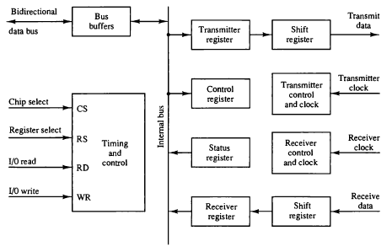
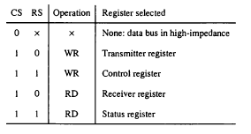
Asynchronous Communication Interface

Slide 30
The interface is initialized for a particular mode of transfer by means of a control byte that is loaded into its control register.
The transmitter register accepts a data byte from the CPU through the data bus.
The transmitter register transfer this data byte to shift register.
At receiving end data receiving at another shift register, and load into Receiver register
The bit in status register are used for input and output flags and for recording certain error

Slide 31
First in first out buffer
FIFO buffer is a memory unit that store information in such a manner that the item first in is the item first out. A FIFO buffer comes with separate input and output terminals. The important feature of this buffer is that it can input data and output data at two different rate and the output data are always in the same order in which the data entered the buffer.

Slide 32
Mode of transfer
The data transfer can be handled by various modes. some of the modes use CPU as an intermediate path, others transfer the data directly to and from the memory unit. Data transfer to and from peripherals may be handled in one of the three possible modes:
i. Programmed I/O
ii. Interrupt-Initiated I/O
iii. Direct Memory Access (DMA)

Slide 33
Programmed I/O
In this mode of data transfer the operations are the results of I/O instructions which is a part of computer program. Each data transfer is initiated by an instruction in the program. Normally the transfer is from a CPU register to peripheral device or vice-versa. Other instruction are needed to transfer the data to and from CPU and memory.
In this I/O device does not have direct access to memory.

Slide 34
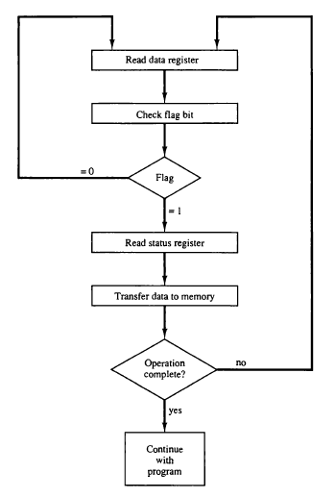
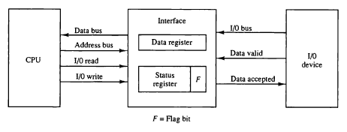

Slide 35
Interrupt-Initiated I/O
Drawback of the Programmed I/O :
The main drawback of the Program Initiated I/O was that the CPU has to monitor the units all the times when the program is executing. Thus the CPU stays in a program loop until the I/O unit indicates that it is ready for data transfer. This is a time consuming process and the CPU time is wasted a lot in keeping an eye to the executing of program.
To remove this problem an Interrupt facility and special commands are used.

Slide 36
In this method an interrupt facility an interrupt command is used to inform the device about the start and end of transfer. In the mean time the CPU executes other program. When the interface determines that the device is ready for data transfer it generates an Interrupt Request and sends it to the computer.
When the CPU receives such a signal, it temporarily stops the execution of the program and branches to a service program to process the I/O transfer and after completing it returns back to task, what it was originally performing.
In this type of IO, computer does not check the flag. It continue to perform its task.
Whenever any device wants the attention, it sends the interrupt signal to the CPU.
CPU then deviates from what it was doing, store the return address from PC and branch to the address of the subroutine.
There are two ways of choosing the branch address:
Vectored Interrupt
Non-vectored Interrupt
In vectored interrupt the source that interrupt the CPU provides the branch information. This information is called interrupt vectored.
In non-vectored interrupt, the branch address is assigned to the fixed address in the memory

Slide 37
Priority Interrupt
There are number of IO devices attached to the computer.
They are all capable of generating the interrupt.
When the interrupt is generated from more than one device, priority interrupt system is used to determine which device is to be serviced first.
Devices with high speed transfer are given higher priority and slow devices are given lower priority.
Establishing the priority can be done in two ways:
Using Software
Using Hardware
A pooling procedure is used to identify highest priority in software means.

Slide 38
Polling Procedure
There is one common branch address for all interrupts.
Branch address contain the code that polls the interrupt sources in sequence. The highest priority is tested first.
The particular service routine of the highest priority device is served.
The disadvantage is that time required to poll them can exceed the time to serve them in large number of IO devices.
Notes:
In this cpu ask from every device that they generated interrupted or not

Slide 39
Using Hardware
Hardware priority system function as an overall manager.
It accepts interrupt request and determine the priorities.
To speed up the operation each interrupting devices has its own interrupt vector.
No polling is required, all decision are established by hardware priority interrupt unit.
It can be established by serial or parallel connection of interrupt lines.

Slide 40
Serial or Daisy Chaining Priority
Device with highest priority is placed first.
Device that wants the attention send the interrupt request to the CPU.
CPU then sends the INTACK signal which is applied to PI(priority in) of the first device.
If it had requested the attention, it place its VAD(vector address) on the bus. And it block the signal by placing 0 in PO (priority out)
If not it pass the signal to next device through PO(priority out) by placing 1.
This process is continued until appropriate device is found.
The device whose PI is 1 and PO is 0 is the device that send the interrupt request.

Slide 41
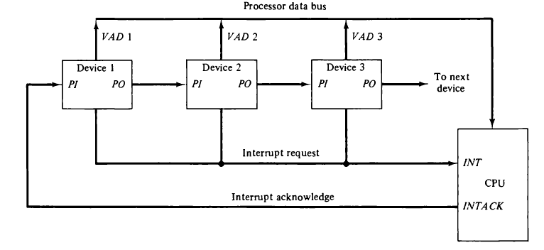

Slide 42
Direct Memory Access (DMA)
The transfer of data between a fast storage device such as magnetic disk and memory is often limited by the speed of the CPU. Removing the CPU from the path and letting the peripheral device manage the memory buses directly would improve the speed of transfer. This transfer technique is called Direct Memory Access (DMA).
During the DMA transfer, the CPU is idle and has no control of the memory buses. A DMA Controller takes over the buses to manage the transfer directly between the I/O device and memory.
The CPU may be placed in an idle state in a variety of ways. One common method extensively used in microprocessor is to disable the buses through special control signals such as:
Bus Request (BR)
Bus Grant (BG)

Slide 43
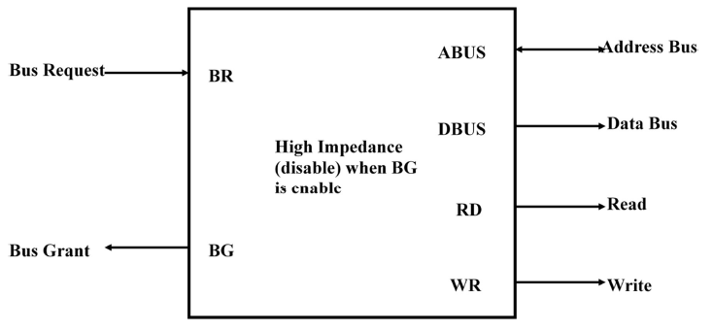
The Bus Request (BR) input is used by the DMA controller to request the CPU. When this input is active, the CPU terminates the execution of the current instruction and places the address bus, data bus and read write lines into a high Impedance state. High Impedance state means that the output is disconnected.
The CPU activates the Bus Grant (BG) output to inform the external DMA that the Bus Request (BR) can now take control of the buses to conduct memory transfer without processor.
When the DMA terminates the transfer, it disables the Bus Request (BR) line. The CPU disables the Bus Grant (BG), takes control of the buses and return to its normal operation.

Slide 44
The transfer can be made in several ways that are:
i. DMA Burst
ii. Cycle Stealing
i) DMA Burst :- In DMA Burst transfer, a block sequence consisting of a number of memory words is transferred in continuous burst while the DMA controller is master of the memory buses.
ii) Cycle Stealing :- Cycle stealing allows the DMA controller to transfer one data word at a time, after which it must returns control of the buses to the CPU.

Slide 45
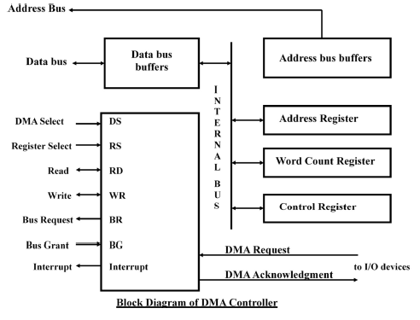
Dma controller
i. Address Register :- Address Register contains an address to specify the desired location in memory. After each word transfer DMA increment its address register.
ii. Word Count Register :- WC holds the number of words to be transferred. The register is decrement by one after each word transfer and internally tested for zero.
iii. Control Register :- Control Register specifies the mode of transfer
All register in the DMA appear to the CPU as I/O interface registers. Thus the CPU can read from or write into the DMA registers under program control via the data bus.

Slide 46
The DMA communicates with the CPU via the data bus and control lines. The registers in the DMA are selected by the CPU through the address bus by enabling the DS (DMA select) and RS (Register select) inputs.
The RD (read) and WR (write) inputs are bidirectional.
When the BG (Bus Grant) input is 0, the CPU can communicate with the DMA registers through the data bus to read from or write to the DMA registers.
When BG =1, the DMA can communicate directly with the memory by specifying an address in the address bus and activating the RD or WR control.

Slide 47
DMA transfer
Peripheral device sends a DMA request,
DMA controller activates the BR line .(informing CPU to relinquish the buses)
CPU responds with its BG line (informing DMA that its buses are disable)
DMA puts its current value of its address register into the address bus, initiates the RD and WR signal, and send DMA acknowledge to the peripheral device.

Slide 48
Input-Output Processor
It is a processor with direct memory access capability that communicates with IO devices.
IOP is similar to CPU except that it is designed to handle the details of IO operation.
Unlike DMA which is initialized by CPU, IOP can fetch and execute its own instructions.
IOP instruction are specially designed to handle IO operation.
Memory occupies the central position and can communicate with each processor by DMA.
CPU is responsible for processing data.
IOP provides the path for transfer of data between various peripheral devices and memory.
Data formats of peripherals differ from CPU and memory. IOP maintain such problems.
Data are transfer from IOP to memory by stealing one memory cycle.
Instructions that are read from memory by IOP are called commands to distinguish them from instructions that are read by the CPU.

Slide 49
